Slide 1
Data-Aware Scheduling
Platform Confidential
Date: Sept, 2009

Slide 2
Data Management Techniques

Slide 3
Session/Task-level Data-aware Scheduling
Dispatch tasks towards their required data sets with soft data affinity
SI₁
Cache API
D1
D3
D5
t2
Cache Server
SSM
Client
SI₂
D1
D2
D3
D4
t1
Cache API
D6
D7
D8
D9
D1
D2
D3
Key(D1, D3, D5)
Hosts
APIs available to query which cache entries are locally cached per SI or per node
Node1
t3
DAS Plug-in
SI_{n}
Node1000
© Platform Computing Inc. 2003
Platform Confidential & Subject to NDA. All rights Reserved.
Notes:
3

Slide 4
Case Study – DAS for Ibrix – Implementation
File Structure:
Host 1
ses = createSession((D1));
t1 = ses.sendTaskInput(in1, (F1, F2));
t2 = ses.sendTaskInput(in2, (F2, F3));
t3 = ses.sendTaskInput(in3, (F1, F3));
SI
Host 2
Client
SSM
SI
Keys
(F1,F2,F3…)
Host 3
Host
SI
Call IBRIX Fusion API for the location of F1, F2, ..
IBRIX Fusion returns the hostname that has the file.
DAS Plug-in return the hostname to SSM
DAS Plug-in
Service
Instances
Fusion
Manager
IBRIX Fusion API:
getHostForPath()

Slide 5
Case Study – DAS for Ibrix – Test Results
Test env: 60 Dual CPU Xeon 3.4 GHz, network: 1Gbit Ethernet. Ibrix: one ibrix segment per compute host, each ibrix segment consisting of a single physical drive Ibrix uses its own separate 1Gbit ethernet network.
Test Case: 698 write tasks each generated 1 G byte file. 698 read tasks each read 1G byte file.
Test Results: The Symphony DAS plugin works as expected, with 90%+ affinity for with-DAS runs. non-DAS affinity was about 3% --- 70% performance improvement over noDAS, which is on top of performance gain by using distributed file systems.

Slide 6
Case Study – DAS for Ibrix – Benefits
Network traffic among nodes in the cluster and between nodes and storages has been significantly reduced.
Less network traffic and faster file access has increased overall application performance and enabled scalability.
Increased the level of consolidation creates savings.
  Eliminate the cost of SAN adapters, switches, and disk arrays for storage services
  Eliminates the cost of dedicated servers running clustered file services.

Slide 7
Symphony DAS with GemFire (Plug-in approach)
GemFire Partition Region
ses = createSession((D1));
t1 = ses.sendTaskInput(in1, (A, B));
t2 = ses.sendTaskInput(in2, (B, C));
t3 = ses.sendTaskInput(in3, (A, C));
Host_1
Partition A
(keys starting
from “A…”)
Client
SSM
Host_2
Partition B
(keys starting
from “B…”)
Keys (A,B,C…)
Host
Host_3
Partition C
(keys starting
from “C…”)
Uses the same hashing to determine partition for the key(s)
Get partion-to-node configuration from GemFire API
Returns host for the resolved partition
DAS Plug-in
Config API
“Partition to Node affinity”
Overwrite default hashing in PartitionResolver

Slide 8
Symphony DAS with GemFire (Publishing API approach)
GemFire Partition Region
ses = createSession((D1));
t1 = ses.sendTaskInput(in1, (A, B));
t2 = ses.sendTaskInput(in2, (B, C));
t3 = ses.sendTaskInput(in3, (A, C));
Publish local keys
Service1
Partition A
(random keys)
Client
SSM
Service 2
Partition B
(random keys)
Service 3
Partition C
(random keys)
Each Service uses GemFire API to get all local keys and publish it to SSM
Register a call-back for local Cache Events in GemFire
On the call-back invocation, it publishes any added, updated or removed key to SSM
GemFire API

Slide 9
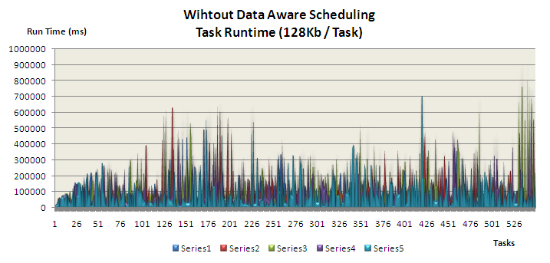
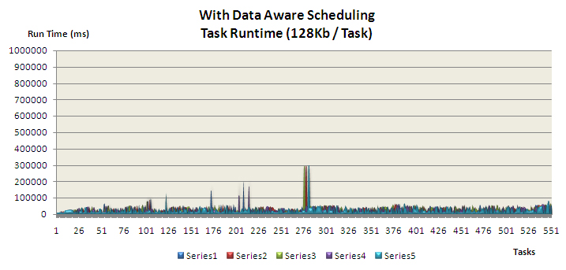
Tier1 Use Case - Test Results

Slide 10
Platform Technology Integration with Hadoop

Slide 11
Hadoop Architecture Review
MapReduce
Client
Job Ops
MapReduce
JobTracker
M/R
State
Hadoop Node
Hadoop Node
MapReduce
TaskTracker
MapReduce
TaskTracker
…
HDFS
DataNode
HDFS
DataNode
Read/Write
HDFS
Client
HDFS
NameNode
HDFS
SecondaryNameNode
Meta-data Ops
HDFS
State
Notes:
A typical Hadoop deployment. Typically, the JobTracker and NameNode processes are run on the same node, but if there is a lot of data or lots of files in HDFS, the processes might be separated to allow the NameNode to have exclusive access to system memory. Similarly for the SecondaryNameNode (which is not a failover service as you might think, but a service to manage HDFS state files for recovery), which could run on the same node as the NameNode, but is on a separate node if memory requirements for the NameNode are high.

Slide 12
Adding Management and Monitoring for Hadoop
EGO Resource
EGO Agents
Hadoop Slave Service
PEM
Control
MapReduce
TaskTracker
LIM
HDFS
DataNode
Monitor
EGO Master
Service Controller
Resource Manager
1. Host crashes
EGO Resource
PEM
EGO Agents
Hadoop Master Service
Hadoop Slave Service Definition
PEM
Control
MapReduce
JobTracker
4. Remove crashed instance
Hadoop Master Service Definition
LIM
LIM
HDFS
NameNode
Monitor
M/R
State
EGO Resource
HDFS
State
EGO Agents
Hadoop Master Service
PEM
Control
MapReduce
JobTracker
Metrics
RTM
DataBase
3. Recover state
LIM
HDFS
NameNode
Monitor
2. Start Hadoop Master on another resource
Notes:
EGO will manage the failover of the Hadoop master service (JobTracker and NameNode processes) to another resource if the first fails. Moreover, EGO knows about the switch, so if the failed node comes back up, the Hadoop master service won’t be automatically restarted on that node.
EGO can also manage the Hadoop slave service (TaskTracker and DataNode) on a given host. EGO will attempt to restart the processes on the node if they fail for some reason.
Hadoop specific metrics can be collected by lim and included in the RTM DB for use in Platform RTM.

Slide 13
LSF Scheduler for Hadoop
HDFS
NameNode
Hadoop JobTracker Node
Scheduler policy & config
Data block to node affinity information
Job Queue Manager
JobTracker
Manage Queues
LSF Scheduler
Q1
Job
Job
Job
Q2
Scheduler state
Job
Job
Job
RPC call: Free slot(s)
Monitor tasks
Job Submit: qname = Q1
RPC return: task to run
view, modify
MapReduce
Client
view, delete
Hadoop Node
submit job
User
TaskTracker
EGO LIM
Node resource information
Notes:
This diagram shows a proposed architecture for integration LSF scheduling with Hadoop. Hadoop already has the concept of queues, which can easily map to LSF’s notion of queues. Users submit M/R jobs to the Job Queue Manager in the Hadoop JobTracker using normal Hadoop API. The LSF scheduler sits to the side and manages the jobs within the queues, using LSF scheduling policies to determine which job goes next. The LSF scheduler can use information such as task slot information from the JobTracker, host resource index information from LIM, and even data block affinity information from the HDFS NameNode for Map task affinity scheduling. LSF policy is configured using existing LSF configuration files and state is persisted using the event log. The main omission is the execution environment based on sbatchd, and thus the mbatchd dispatch code is really just dispatching jobs to different positions in the Hadoop queues.

Slide 14
Symphony MapReduce architecture
Client host
Master
Compute
node
MapReduce service
MR main()
Symphony
Map Reduce
JobTracker
(library)
SDK API
SIM
SDK API
SSM
Symphony
Map Reduce
TaskTracker
(library)
records
DAS plug-in
for HDFS
Mapper
Reducer
HDFS
Name node
HDFS
Data node
File System
Components:
- Symphony product
- Symphony MapReduce framework
- Meta-data flow
- Distributed file system (HDFS)
- User data flow
User-defined MapReduce programs
(main, Mapper and Reducer)
Notes:
User-created Job client program includes at least 3 objects:
Mapper (input: key/value, output: set of key/value pairs)
Reducer (input: key/set of values, output: set of key/value pairs)
Main MR Job class (define Job configuration, starts the Job, print out Job statistics, wait for completion and may cancel the Job)
Optionally the program may includes:
Combiner (same input/output as reducer, but run locally on each host after Mapper) to reduce local Mapper’s data output and optimize remote data transfer – by default set to Reducer
Custom InputFormat and OutputFormat objects (includes class of splitting files in records (InputSplitter)
Custom RawComparators to control sorting and grouping keys from Mapper outputs for Reducer input (“shuffle process”)
Custom Partitioner to control which key goes to which Reducer
Custom CompressionCodecs to compress intermediate outputs

Slide 15
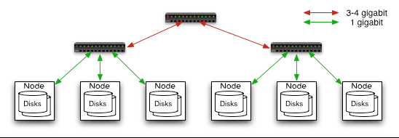
Scalability at Facebook
Hardware 2 level architecture
  Nodes are commodity PCs
  30-40 nodes/rack
  Uplink from rack is 3-4 gigabit
  Rack-internal is 1 gigabit
Very Large Distributed File System
  10K nodes, 100 million files, 10 - 100 PB
Optimized for Batch Processing
  Data locations exposed so that computations can move to
  where data resides
User Space, runs on heterogeneous OS

Slide 16
HDFS Performance at Facebook
80K compute hours per day
4 TB of compressed new data added per day
135TB of compressed data scanned per day
7500+ Hive jobs (SQL adapter to MapReduce) on production cluster per day
Common design pattern in data processing
  cat * | grep | sort | unique -c | cat > file
  input | map | shuffle | reduce | output
Used for:
  Log processing
  Web search indexing
  Ad-hoc queries

Slide 17
Hadoop Scalability/Performance at Yahoo
HDFS total 25000 nodes with Hadoop (4000 nodes per cluster), 82 Petabytes of data
Map reduce on 2000 nodes
20TB sort on 2000 nodes takes ~2 hours
Distributed File System in daily use:
  1.5 PB (file size up to 20GB replication: 3)
  Few millions of files

